Slide 1
TFS Cloud Catalog, Roadmap, Patterns (draft)
October 2019

Slide 2







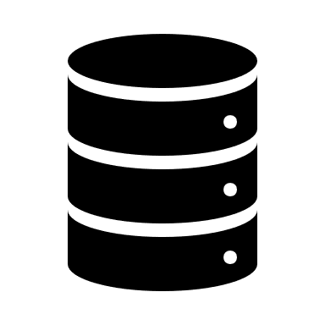


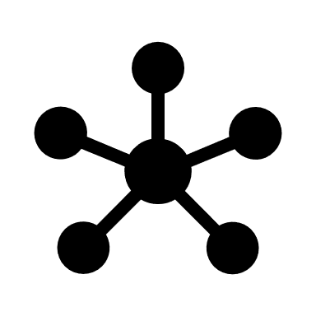






















Cloud Capability Model
Public Cloud Infrastructure
PaaS
SaaS
Job Scheduling
Automation & Orchestration
Backup
IP Address Mgmt
Configuration Mgmt
Patch Mgmt
General Services
Operating System
Database Platform
Data Warehouse Platform
Platforms
Load Balancing
DNS
Network
Firewall & IPS
Directory Services
Core Services
System Health Monitoring
Application Performance Monitoring
End User Experience Monitoring
Event Correlation
Monitoring
KMS
Encryption
Identity
Endpoint Threat Prevention
DLP
SIEM
Vulnerability Mgmt
Security
Extract
Transform
Load
API Management
Integration
Code Repository
Artifact Repository
Build
Test
Deploy
Comply
Financial Mgmt
Lifecycle Services

Slide 3
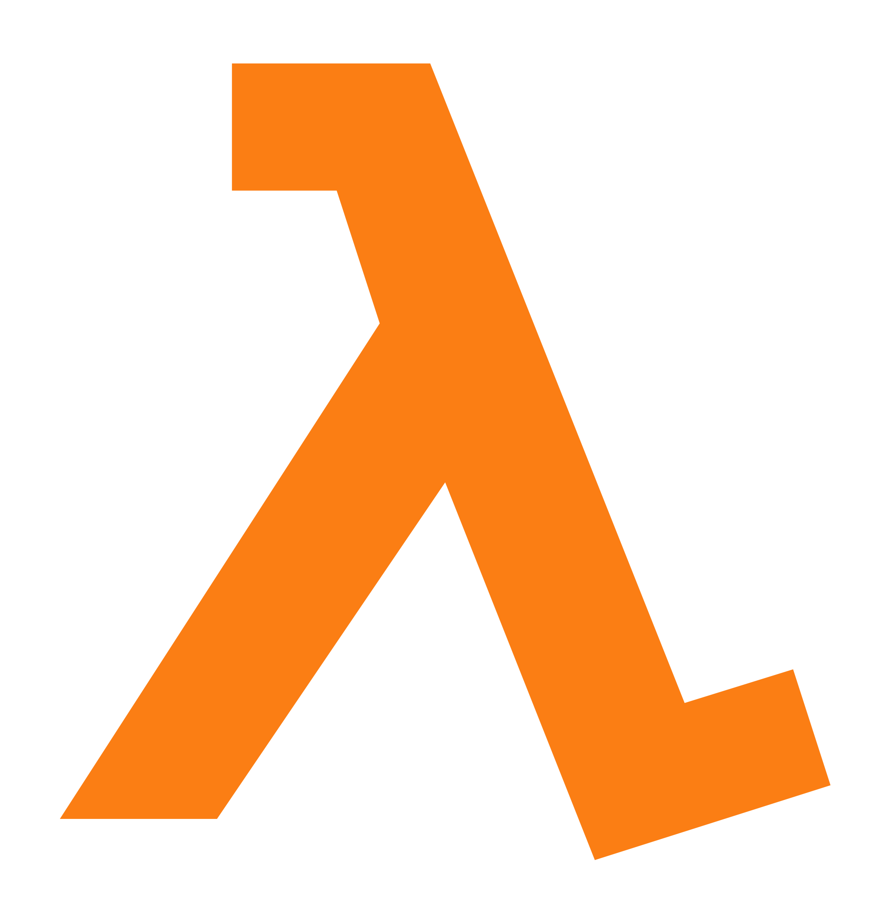
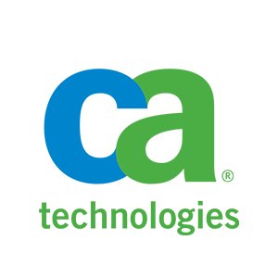

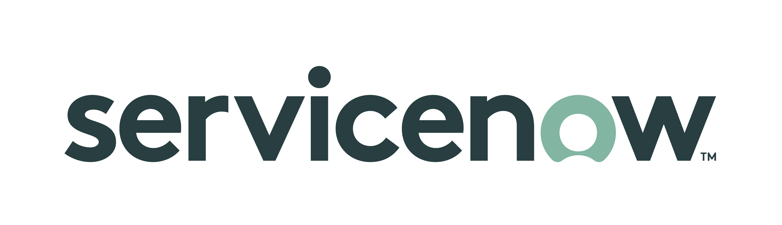
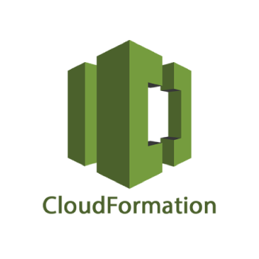
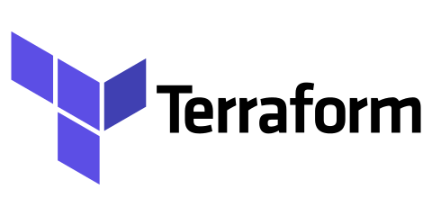



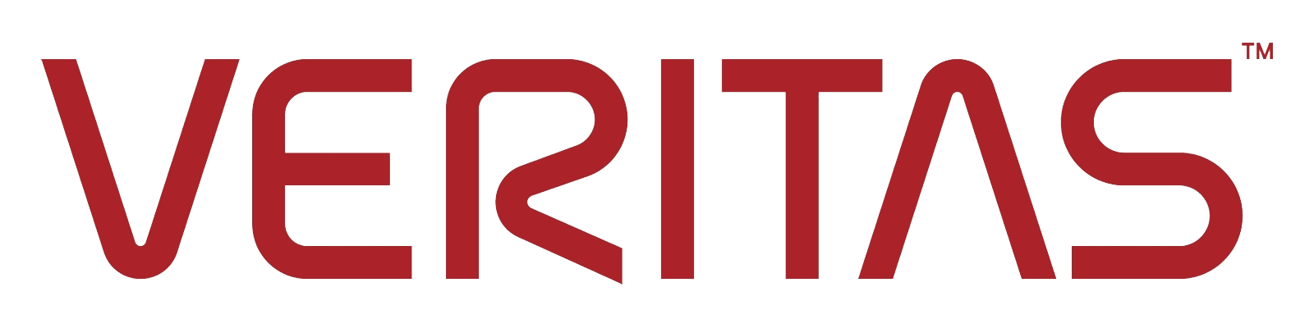
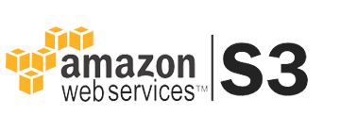

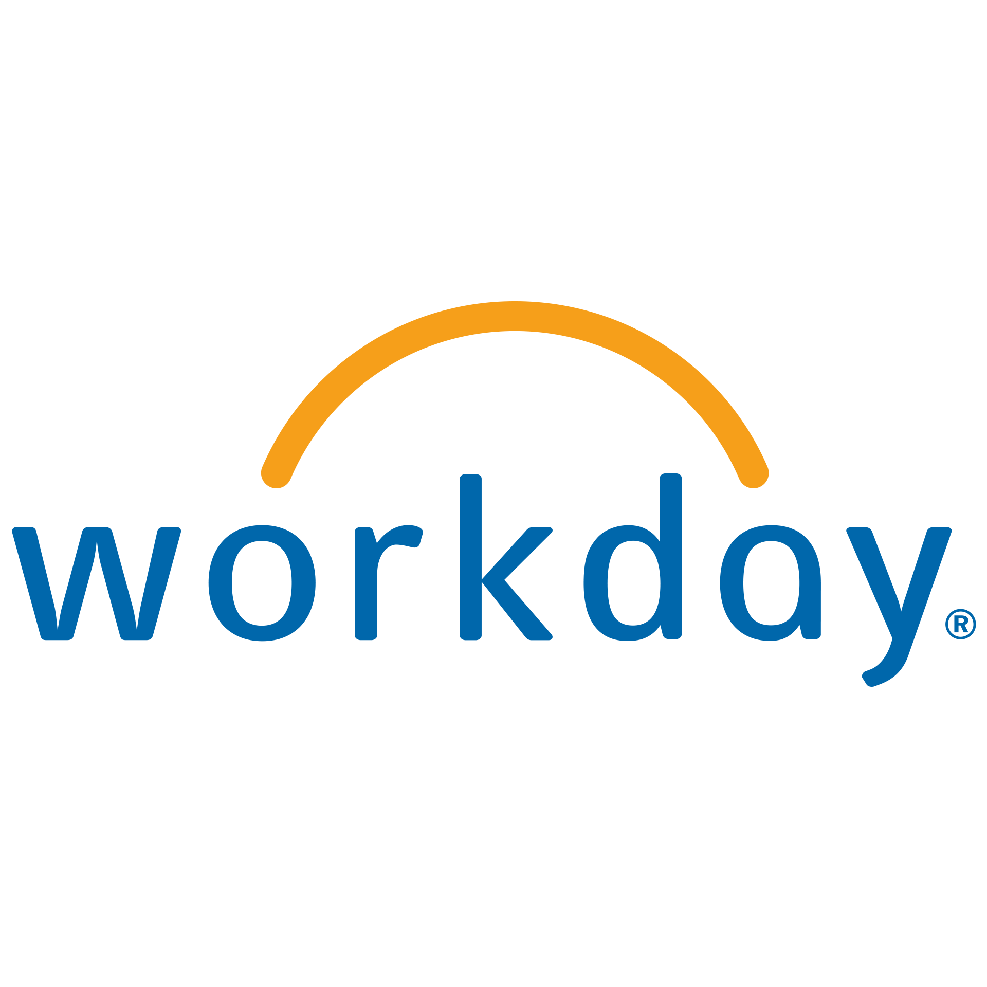






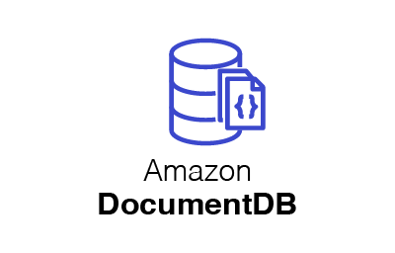





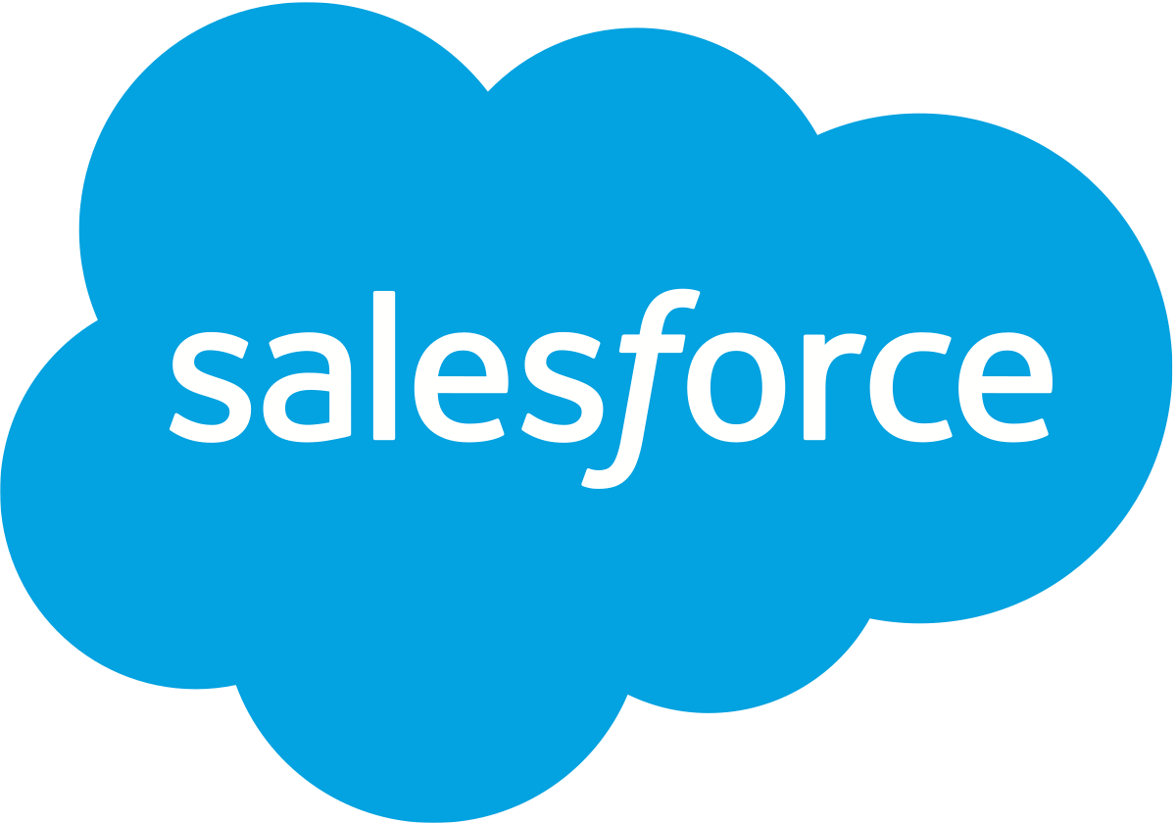
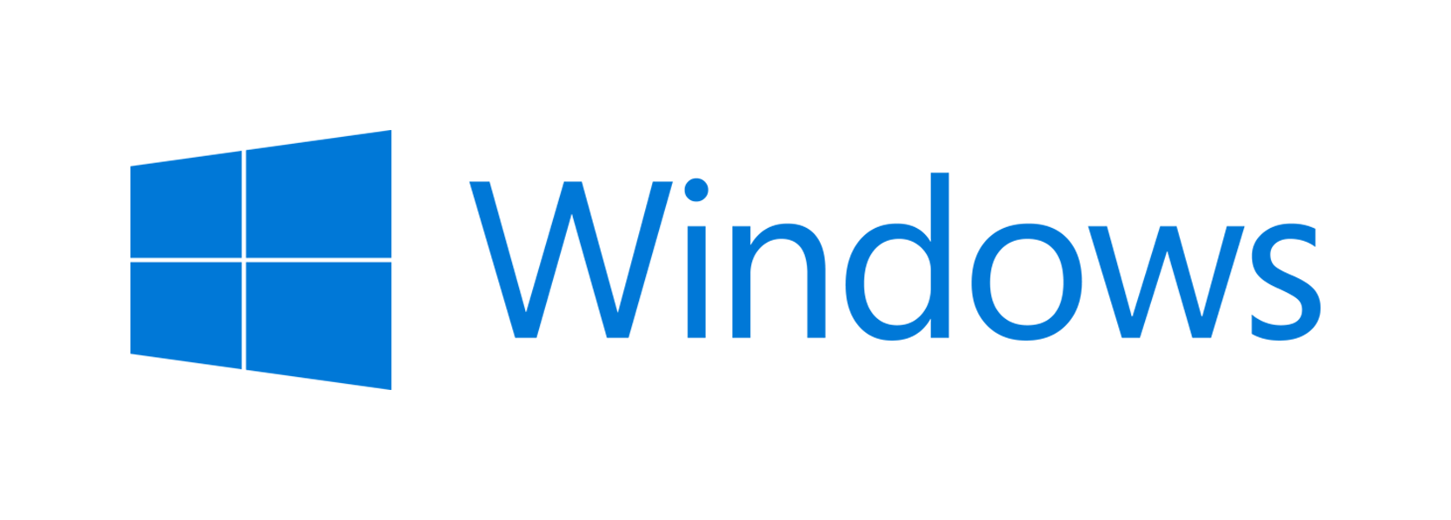

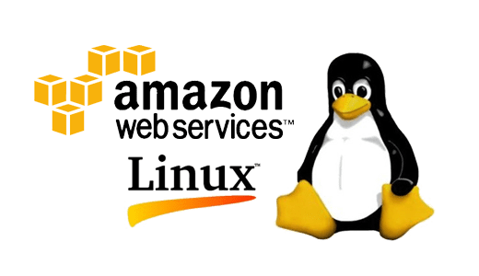
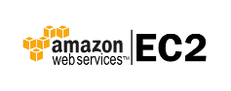

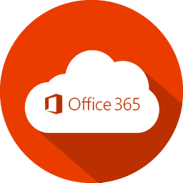



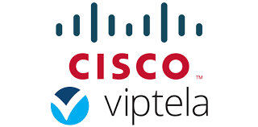
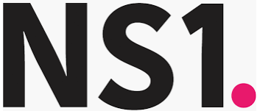
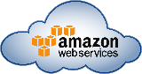
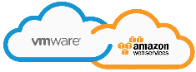
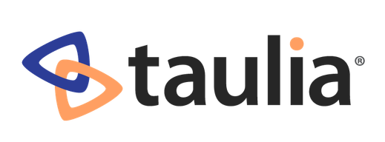
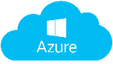


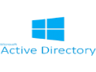
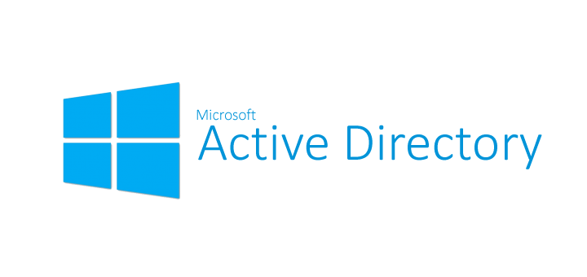


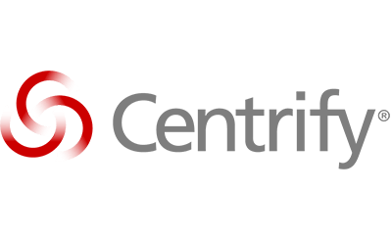








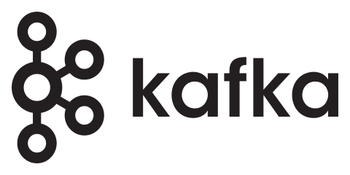
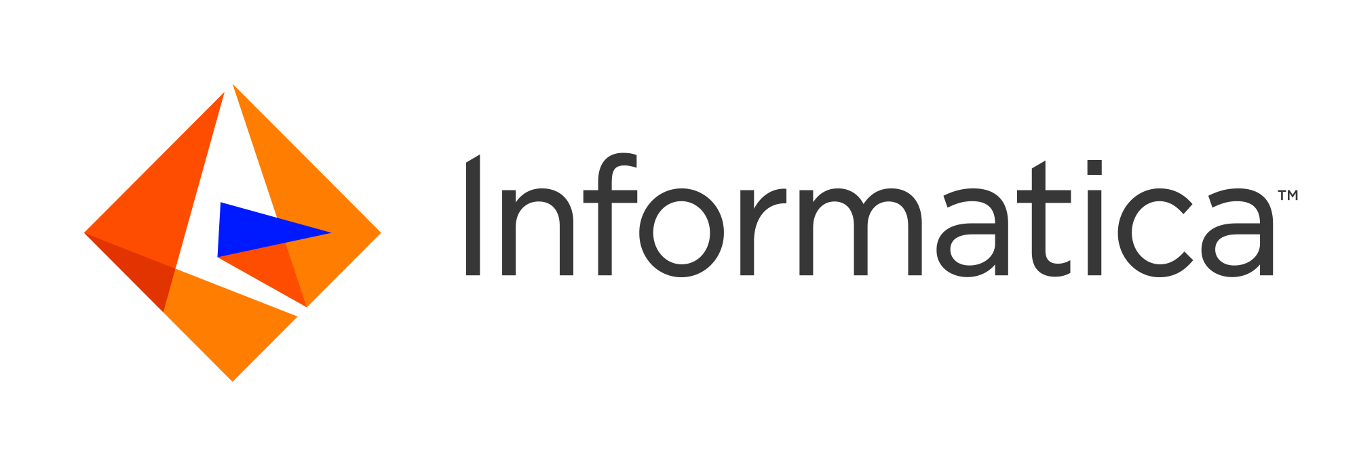
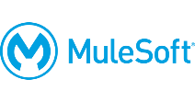
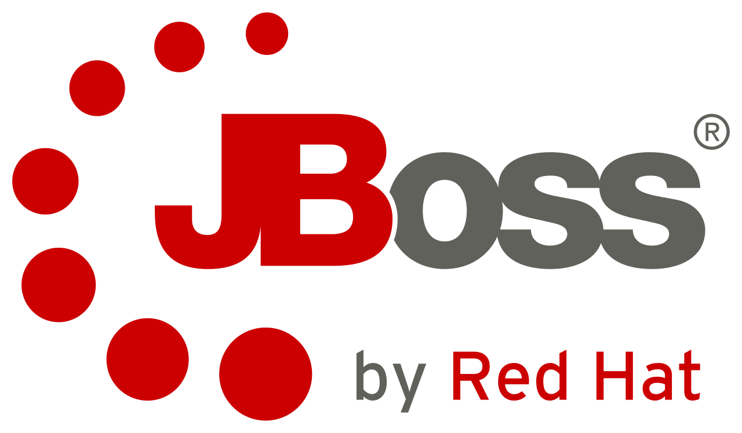


TFS Technology Landscape for Cloud
Job Scheduler
PaaS
SaaS
AutoSys
Automation / Orchestration
Backup
IP Management
Configuration Management
Patch Management
Satellite
System Manager
Database Platforms
Operating Systems
Virtualization / Containers
EFS
Storage
Network
Public Cloud Infrastructure
KMS
CASB
Encryption
Security/IAM
CASB
Encryption
IBM Sterling MFT
Logging/Monitoring
Operations Manager
Integration / Data / Middleware
In POC
Future Evaluation
In Pilot

Slide 4
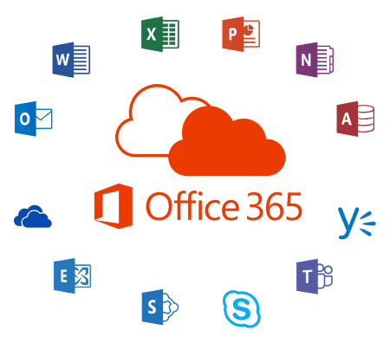

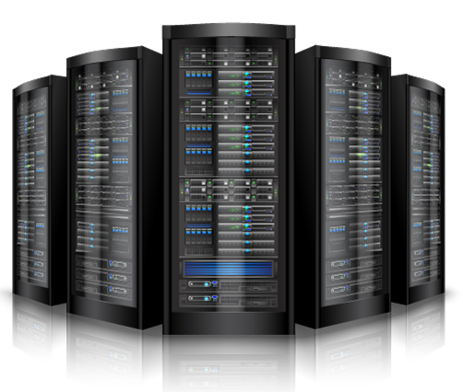
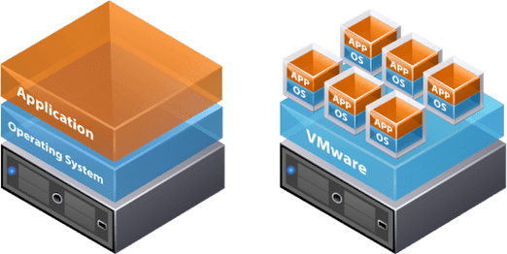
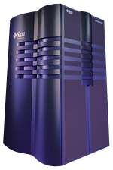
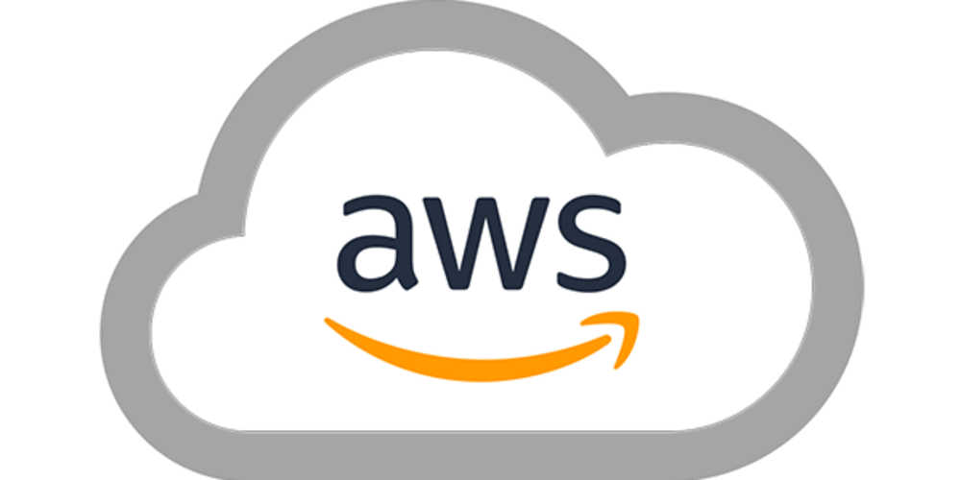

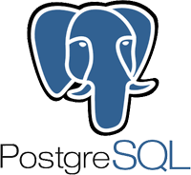
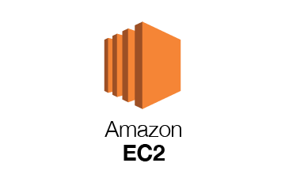
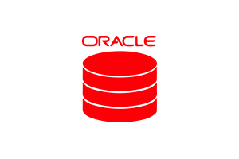
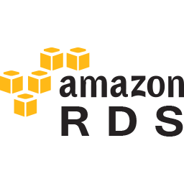
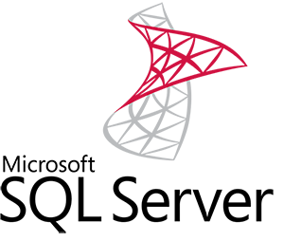
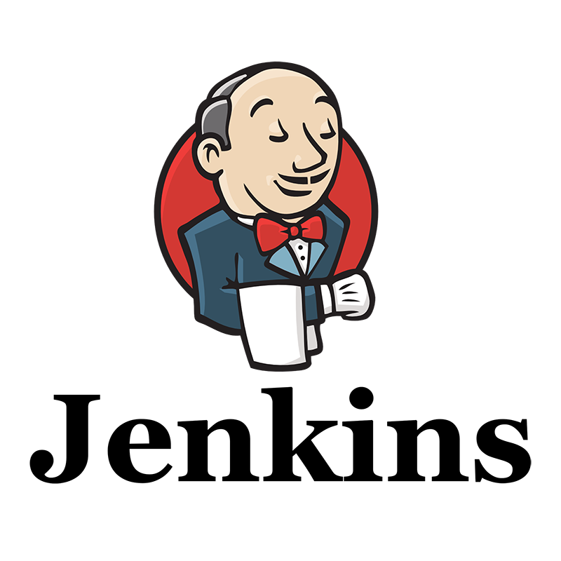
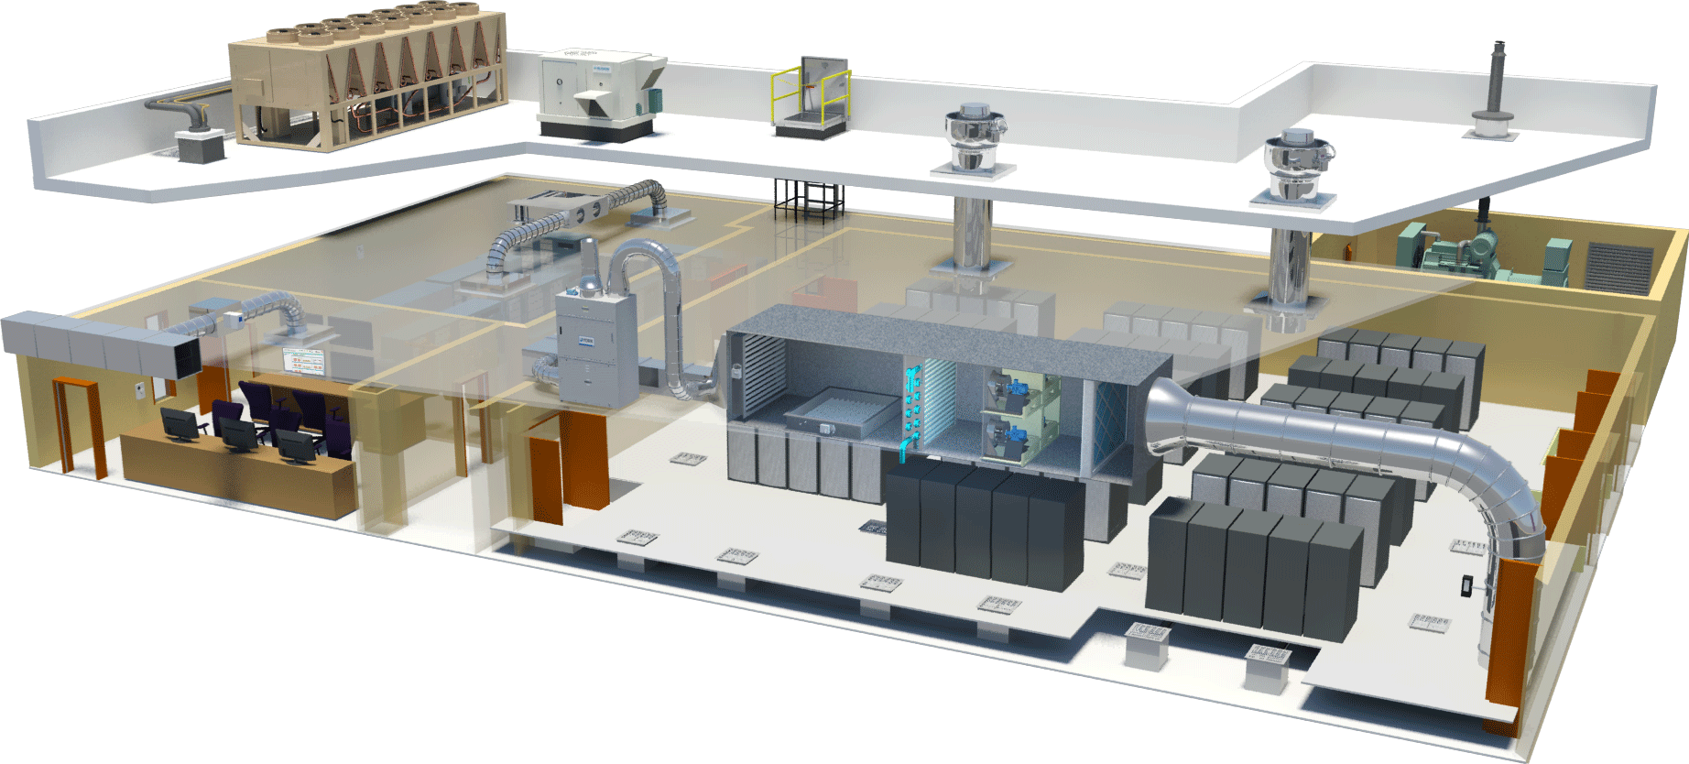

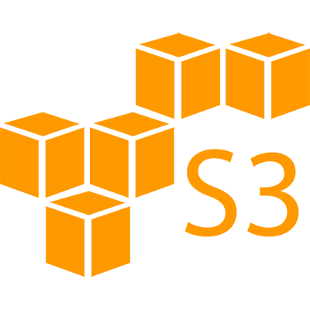

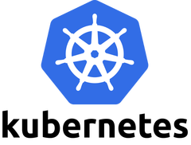
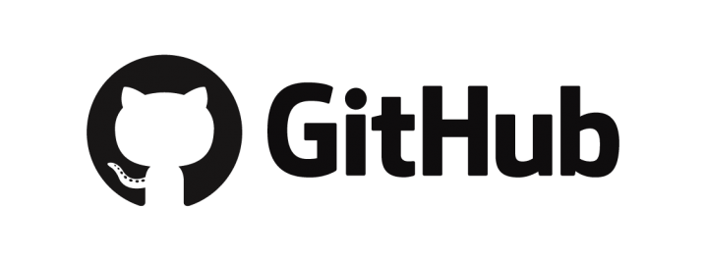
TFS Cloud Roadmap
Past Present Future
TCP
TCD
TCX
DDC
TCX
TCX
Modern IT
Private Cloud & Some Public Cloud
Automated Virtual Provision
Some Automation & Orchestration
Provisioning Time : Days to Weeks
Cloud Driven Agile IT
Majority Public Cloud
Platform Agility with Self-Service
DevOps Integrated Automation & Orchestration
Provisioning Time: In Minutes
Traditional & Legacy IT
Physical & Virtual s
No Automation & Orchestration
On Prem Infra and Apps
Provisioning Time : Months
4

Slide 5

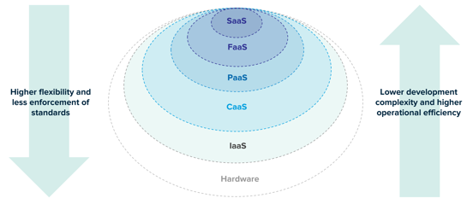
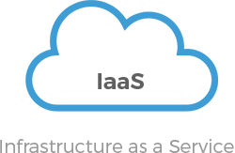
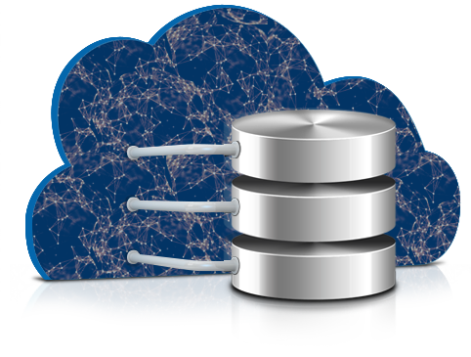
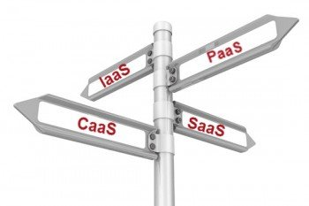
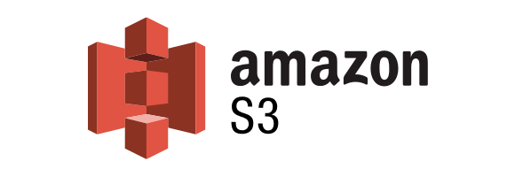
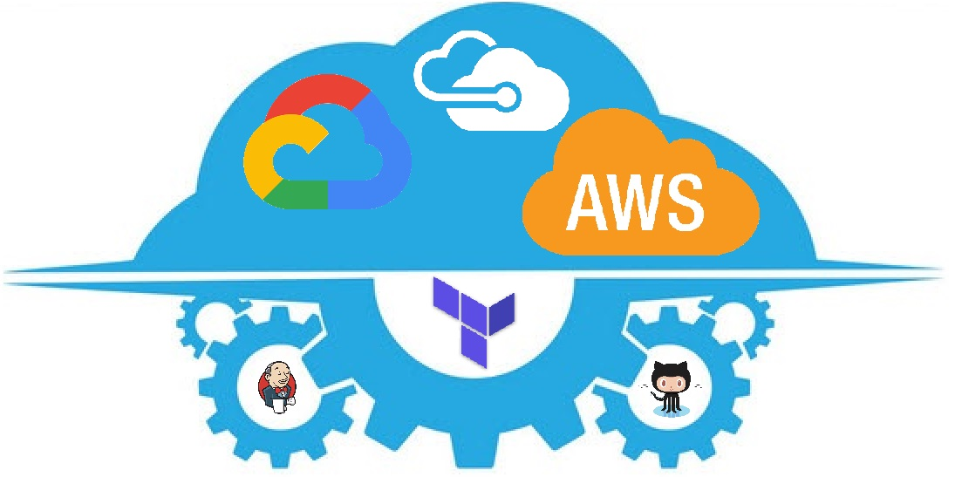

What self-service options are available today?
Kubernetes/Containers Platform (CaaS)
for Cloud Native/Modern Applications
Lowest RTO/RPO
Easy to do multi-tenancy, automate & Integrates well in CI/CD pipelines
DevOps enabled platform
Infrastructure as a Service (IaaS)
For traditional/COTS Applications
Windows & Linux s
High RTO/RPO
Hard to do multi-tenancy, automate & Integrate with CI/CD pipeline
Database as a Service (DBaaS)
PostgreSQL RDS / DocumentDB
Lowest RTO/RPO
Easy to do end-to-end automation & Integrates with CI/CD pipelines
DevOps enabled platform
Amazon AWS S3 Storage (available 10/15)
Artifactory
DNS Provisioning
* Other AWS Services are provisioned manually through Intake process

Slide 6

mFin AWS environment readiness
mFin AWS Infrastructure readiness timeline
Dev/Test Available now
Kubernetes/Containers, EC2 Windows/Linux, S3
RDS PostgreSQL & DocumentDB (Available 10/27/2019)
Stage ready by 10/27/2019
Production by 11/30/2019
The above dates are only for Infrastructure readiness
Available for factories/applications to build their applications
Using self-service ServiceNow standard cloud catalog
Eg. Linux/Windows EC2 servers, Kubernetes, S3, RDS/NoSQL databases
Everything else to be build manually through intake process based on priority

Slide 7


Building mFin/multi-tenant Environments
Follow the mFin Architecture guidelines
Build loosely coupled , cloud native, scale-out/elastic applications
Build resiliency into Application
Don’t solely rely on the infrastructure for availability
Assume everything fails, and design backwards
Multi-AZ/Region Architecture based on business requirements to avoid single point of failure
Availability/Outage & Performance issues of one tenant should not impact the other tenants
Other things to consider as each tenant may have :
Different Access, Audit, Security and compliance requirements
Different HA/DR testing & maintenance window
Release cycles, feature requests and upgrades
Different data / backup retention requirements
Disposing or exporting environments/data at the request of tenant

Slide 8

















TFS Cloud foot print
Restricted Accounts
TFSAWSMASTER
TFSAWSMGMT
Payer Account
Manage Organization Policies
IAM Role
TFSAWSIAC
Landing Zone and Logging Account
Infrastructure as Code components
General TFS Accounts
MFIN1 Accounts
All MFIN compliant workloads
TFSAWSSUBPROD
TFSAWSPROD
MFIN1AWSPROD
us-east-1
us-west-2
us-east-1
us-west-2
us-east-1
STAGE VPC
NS VPC
NS VPC
PROD VPC
DEV VPC
PROD-DR VPC
Firewall and Network Services
Firewall and Network Services
Sub-Prod workloads
ES VPC
ES VPC
Enterprise Services
MFIN1AWSSUBPROD
TFSAWSEIP
Enterprise Services
us-east-1
us-east-1
PROD-DR VPC
PROD VPC
STAGE VPC
Prod workloads
PROD VPC
Production workloads
Production workloads
DEV VPC
DEV VPC
Sub-Prod workloads
Restricted Account for TFSIC
TFSICAWSTFPP
STS Assume-role
eu-central-1
Prod workloads
PROD VPC
DEV VPC
Sub-Prod workloads

Slide 9
Four levels of DR support across a spectrum of complexity and time
Backup & Restore
Pilot light
Warm/Hot standby
Active/Active
RPO/RTO: Hours/Days
RPO/RTO: Hours
RPO/RTO: Minutes
RPO/RTO: Near Real-time
Lower priority use cases
Solutions: S3
Non critical services
Cost: $
Meeting lower RTO & RPO requirements
Less critical business services
Scale AWS resources in response to a DR event
Cost: $$
Solutions that require RTO & RPO in minutes
Business critical services
Cost: $$$
DB Cross Region Replication
Auto-failover of your environment in AWS
Core Enterprise Services: eg. AD
Cost: $$$$

Slide 10








Pattern - Disaster Recovery using Backup & Restore
US-East-1
Backup to another region
Use managed database services (eg. RDS)
Store backups using S3 / Glacier
Data stored with high durability in multiple locations
Applications/Databases are recovered using backup
App1
App2
Database
Web
Backups
US-West-2
Down time (RTO)
LOW
Data loss (RPO)
HIGH
Cost
Complexity

Slide 11






Pattern: Pilot light (Before DR)
US-EAST-1
US-WEST-2
AZ1
AZ2
AZ3
AZ1
AZ2
AZ3
Web
Web
Web
Web
App1
App2
App3
Snapshots
AMIs:
Web, App, Database
App2
Snapshots
AMIs:
Web, App, Database
App2
Snapshots
Synchronization
Database Master
Database Replica
Database
Synchronization
Down time (RTO)
Allows the scaling of redundant sites during a failure scenario
Data loss (RPO)
LOW
HIGH
Cost
Complexity

Slide 12

Pattern: Pilot light (After DR)
US-EAST-1
US-WEST-2
AZ1
AZ2
AZ3
AZ1
AZ2
AZ3
Web
Web
Web
Web
Web
Web
App1
App2
App3
Snapshots
AMIs:
Web, App, Database
App1
App2
App3
Snapshots
AMIs:
Web, App, Database
Database Master
Database Master
Down time (RTO)
LOW
Data loss (RPO)
HIGH
Allows the scaling of redundant sites during a failure scenario
Cost
Complexity

Slide 13

Pattern: Warm Standby (Before DR)
US-EAST-1
US-WEST-2
AZ1
AZ2
AZ3
AZ1
AZ2
AZ3
Web
Web
Web
Web
Web
Web
App1
App2
App3
Snapshots
AMIs:
Web, App, Database
App1
App2
App3
Snapshots
AMIs:
Web, App, Database
Snapshots
Synchronization
Database Master
Database Replica
Database
Synchronization
Down time (RTO)
LOW
Data loss (RPO)
HIGH
Cost
Complexity

Slide 14


Pattern: Warm Standby (After DR)
US-EAST-1
US-WEST-2
AZ1
AZ2
AZ3
AZ1
AZ2
AZ3
Web
Web
Web
Web
Web
Web
App1
App2
App3
Snapshots
AMIs:
Web, App, Database
App1
App2
App3
Snapshots
AMIs:
Web, App, Database
Database Master
Database Master
Down time (RTO)
LOW
Data loss (RPO)
HIGH
Cost
Complexity

Slide 15




Pattern 1 - Active/Active (read local, write global)
Users in
New York
Read & Write
Users in
Los Angeles
write
read
US-EAST-1
US-WEST-2
AZ1
AZ2
AZ3
AZ1
AZ2
AZ3
Web
Web
Web
Web
Web
Web
App1
App2
App3
Snapshots
Synchronization
App1
App2
App3
Snapshots AMIs:
Web, App, Database
Snapshots
AMIs:
Web, App, Database
Database Master
Database Replica
Database
Synchronization
Down time (RTO)
LOW
Data loss (RPO)
HIGH
Cost
Complexity

Slide 16
Pattern 2: Active/Active (read local, write local)
Multi-master, multi-region
Users in
San Francisco
Users in
New York
Read & Write
Read & Write
US-WEST-2
US-EAST-1
AZ1
AZ2
AZ3
AZ1
AZ2
AZ3
Web
Web
Web
Web
Web
Web
App1
App2
App3
App1
App2
App3
Snapshots AMIs:
Web, App, Database
Snapshots AMIs:
Web, App, Database
Database Master
Database Master
Database
Synchronization
Down time (RTO)
LOW
Data loss (RPO)
HIGH
Cost
Complexity

Slide 17













EKS: Warm Standby (Before DR)
Snapshots
Synchronization
US-WEST-2
US-EAST-1
Database
Synchronization
AZ1
AZ2
AZ3
AZ1
AZ2
AZ3
Snapshots
Storage class, Database
Snapshots
Storage class,Database
Web
Web
Web
Web
Web
Web
App1
App3
App1
App2
App3
App2
Database Master
Database Replica
Database
Synchronization
Down time (RTO)
LOW
Data loss (RPO)
HIGH
Cost
Complexity

Slide 18

Pattern-1 EKS: Warm Standby (After DR)
Snapshots
Synchronization
US-WEST-2
US-EAST-1
AZ1
AZ2
AZ3
AZ1
AZ2
AZ3
Snapshots
Storage class, Database
Snapshots
Storage class, Database
Web
Web
Web
Web
Web
Web
App1
App2
App3
App1
App2
App3
Database Master
Database Master
Down time (RTO)
LOW
Data loss (RPO)
HIGH
Cost
Complexity

Slide 19

Pattern 1 EKS: Active/Active (read local, write global)
Users in
New York
Users in
San Francisco
Read
Read
Write
US-EAST-1
US-WEST-2
Snapshots
Storage class, Database
AZ1
AZ2
AZ3
AZ1
AZ2
AZ3
Snapshots
Storage class, Database
Web
Web
Web
Web
Web
Web
App3
App1
App1
App1
App1
App2
Database Master
Database Replica
Down time (RTO)
Cost
LOW
Data loss (RPO)
HIGH
LOW
HIGH
Complexity

Slide 20
Pattern 2 EKS: Active/Active (read local, write local)
Multi-master, multi-region
Users in
New York
Users in
San Francisco
Read & Write
Read & Write
US-EAST-1
US-WEST-2
Snapshots
Storage class, Database
AZ1
AZ2
AZ3
AZ1
AZ2
AZ3
Snapshots
Storage class, Database
Web
Web
Web
Web
Web
Web
App3
App1
App1
App1
App1
App2
Database Master
Database Master
Down time (RTO)
Cost
LOW
Data loss (RPO)
HIGH
LOW
HIGH
Complexity

Slide 21


Application Migration Patterns : 6 R’s

Slide 22

Recommendations & Best Practices
Build Cloud Native Applications & Databases
End-to-End Automation
Build Application in Multiple Availability Zones (AZ)
Build Stateless/immutable Containers
All Code & Config must be in GIT repository
Artifacts/binaries should be in Artifactory Repository
Only Production is a permanent environment
Everything else should be on-demand only
Build and destroy after each iteration
Frequent Backup& Recovery and DR Testing

Slide 23

Additional Information
How to consume cloud services?
Self-Service (CaaS, DBaaS & IaaS) provisioning
➔ ServiceNow (https://tfs.service-now.com)
➔ Service Catalog
➔ IT Only Requests
➔ Cloud Infrastructure Services
Weekly Intake Meeting
Complete the Intake Meeting Request Form
Provide Jira EPIC link in the form
Join the Intake Meeting
When : Every Monday : 1-2:30pm
Where : TFSHQ-W3-4D-02
Have additional Questions?
Daily Drop-in/Standup Meeting
When : Monday-Thursday: 4-5pm
Where : TFSHQ-W3-4C-14

Slide 24
Demo

Slide 25
Q&A

Slide 26
Cloud Native Kubernetes Platform (CaaS)
Build Cloud Native Apps (Micro Services)
DevOps enabled Cloud Infrastructure
AWS EKS Kubernetes/Container Management (CaaS)
Fully Self-Service Automated Platform
Factory is responsible for application automation
Resiliency(HA/DR) built into the Application
Integrates well with application DevOps Toolchain (CI/CD)
Provides lowest RTO/RPO

Slide 27


Tradition Apps in AWS (IaaS)
CIO direct report approval for cloud builds
CIO approval for on-premise builds
Exception Documentation Required
Self Service IaaS through Automation
build through automation
Built by Infrastructure as Code (IaC)
Resiliency(HA/DR) built into the Application
AWS Database Platform
Only PostgreSQL(RDS) or DocumentDB
No Oracle & MS SQL databases
Factories are responsible for Application Automation
Not easy to integrate with CI/CD pipeline
Not DevOps enabled platform by default
High RTO/RPO
Auto approval
BIO Approval
CIO Approval
AZ
AZ
AZ
EKS Management
Worker Node
Pods/Containers
CaaS IaaS IaaS

